Slide 1




Digital Forensics and Steganography
Module 2

Slide 2
Learning Objectives
To understand basic digital forensic investigation, preservation, and analysis
To gain understanding of steganographic techniques, tools, and analysis

Slide 3
Topic Outline
Digital forensic concepts, Techniques, and tools
Investigation, preservation, and analysis
Concepts and techniques of steganography
Steganographic analysis

Slide 4
Digital Forensics
Identification, preservation, and analysis of information
Purpose is to establish the validity of the hypotheses used in an attempt to explain the cause of an activity under investigation

Slide 5
Four Major Stages
Acquisition
Identification
Evaluation
Presentation

Slide 6
Acquisition
Collecting evidence is a methodical, slow, careful, and deliberate process
Preserve data in its original form
Freeze the scene
Acquire as much volatile information as possible
Use a dedicated acquisition/analysis system
Document all your steps/activities

Slide 7
Acquisition
Prevent contamination
Mobile devices must be isolated (turn off, remove the battery, and use a Faraday bag)
For computers, record any information on the screen and, if there is no apparent destructive software running, keep it on. Otherwise, immediately disconnect the power.
Install write-blocking software
Select the extraction method

Slide 8
Acquisition
Preserve the evidence
create an image using the USBIT tool
Calculate a hash signature of the image using the FCIV tool

Slide 9
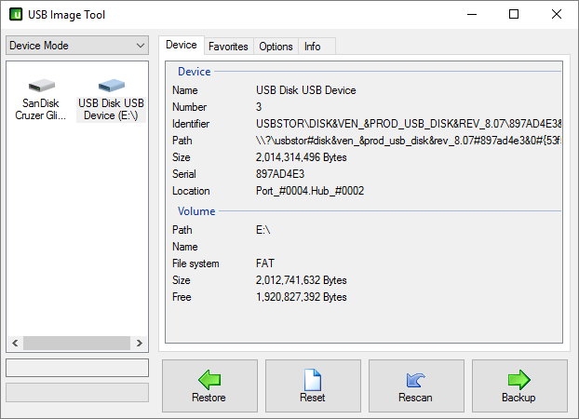
USB Image Tool

Slide 10
Check for Understanding Q1
http://app.gosoapbox.com
Event code: 288095730
The icon depicting the USB drive on the USB Image Tool (USBIT) Graphical User Interface (GUI) is an example of which cyber security principle?
A. Modularity
B. Minimization
C. Process isolation
D. Abstraction

Slide 11
File Checksum Integrity Verification (FCIV) Tool
To calculate the hash value of the image file, sample.img, and save the MD5 signature (hash value) in a text file, MD5_out.txt, type on the Windows command prompt:
FCIV sample.img > MD5_out.txt

Slide 12
Identification
Secure and label all evidence
Document all system parameters and hardware involved
Follow established chain of custody procedure

Slide 13
Evaluation
Recover and make a list of deleted files
Examine the recovered files
Recent activity
File type identification
Exchangeable Image Format (EXIF) information
Extension mismatch
Search for keyword(s)
Record all steps taken

Slide 14
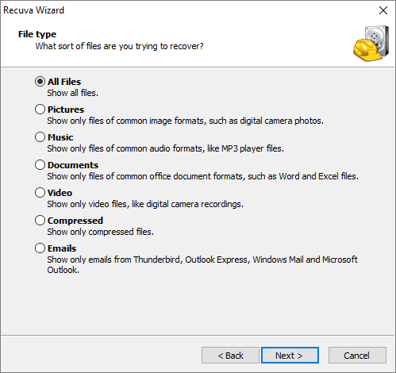

Recuva Recovery Tool

Slide 15
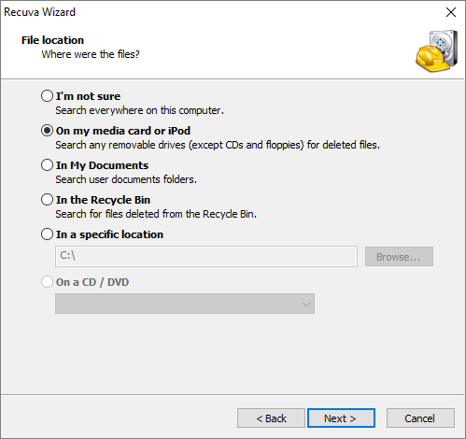
Recuva Recovery Tool

Slide 16
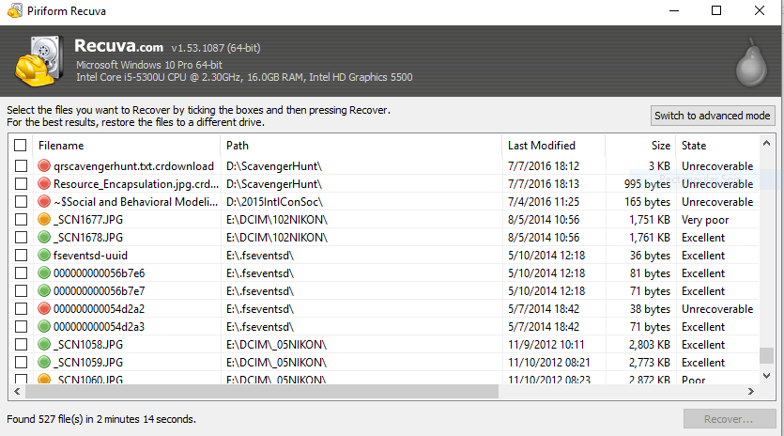
Recuva Recovery Tool

Slide 17
Presentation
Write a comprehensive report which will include the following:
data acquisition,
evidence preservation,
chain of custody,
evaluation process,
analysis of results, and
tools used

Slide 18
Check for Understanding Q2
http://app.gosoapbox.com
Event code: 288095730
The best way to preserve the integrity of a digital evidence is by
A. compressing and saving it.
B. encrypting and saving it.
C. saving it on a USB drive.
D. creating its image, obtaining its hash value (MD5), then saving the image and its hash value.

Slide 19
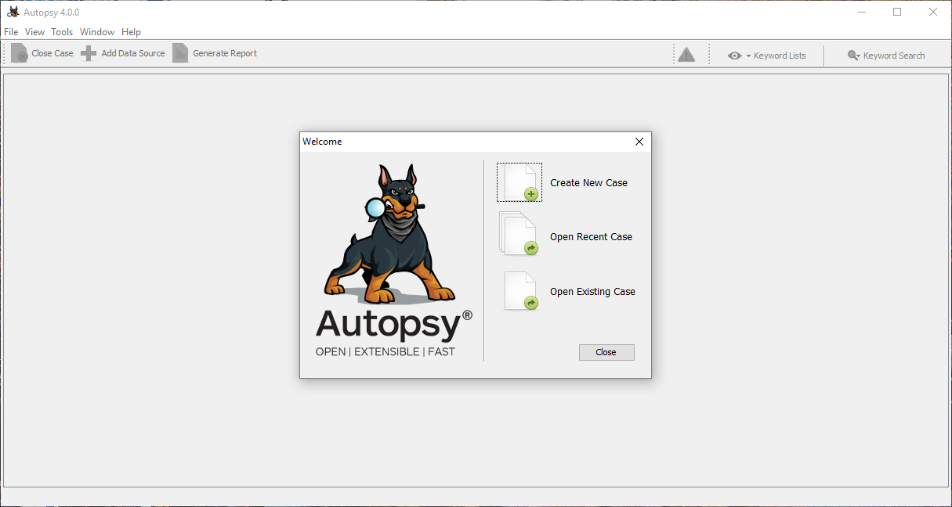
Autopsy

Slide 20

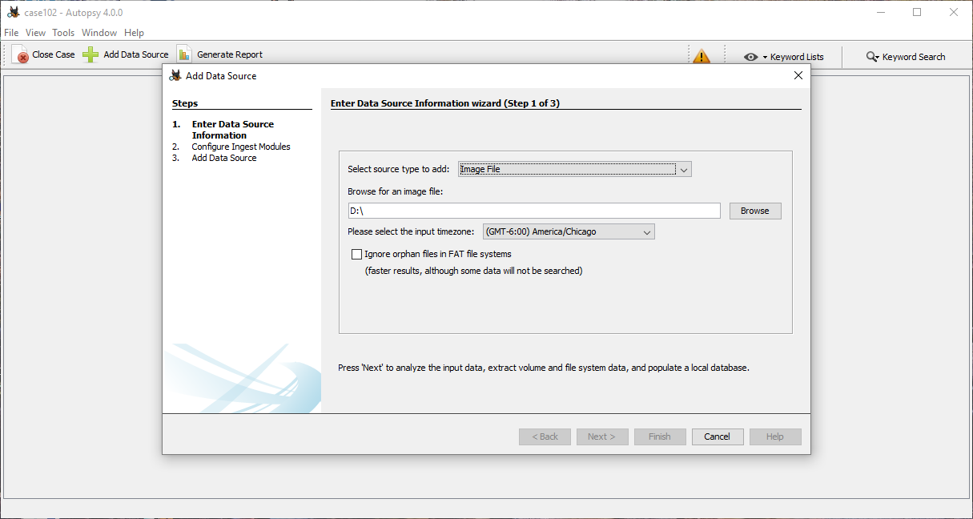

Slide 21

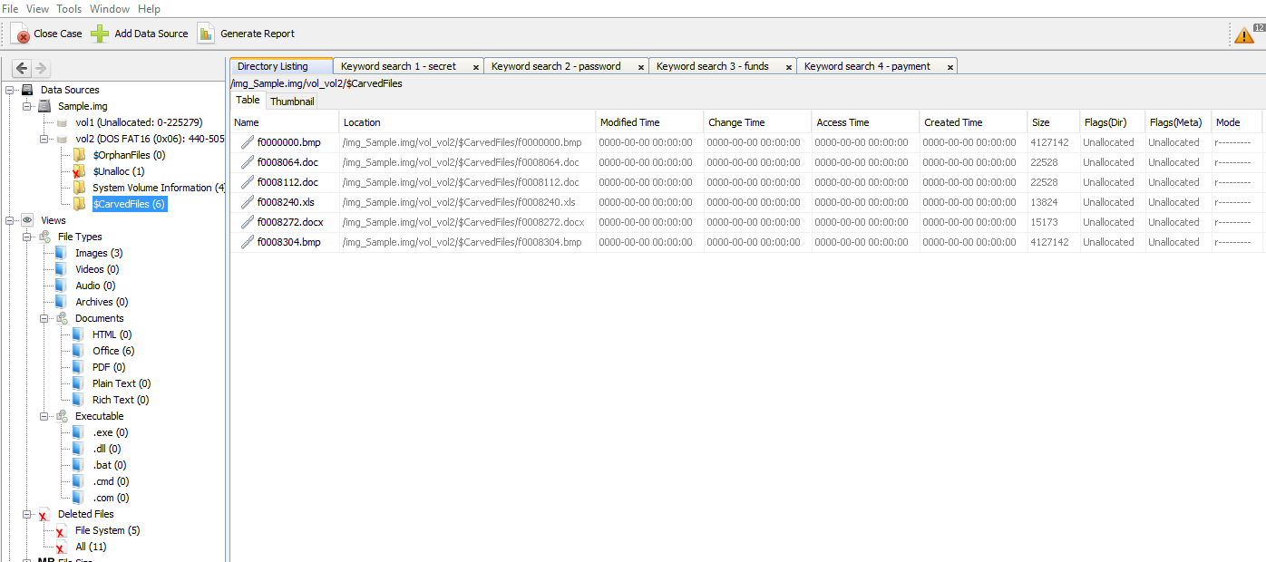
Carved files and File types

Slide 22
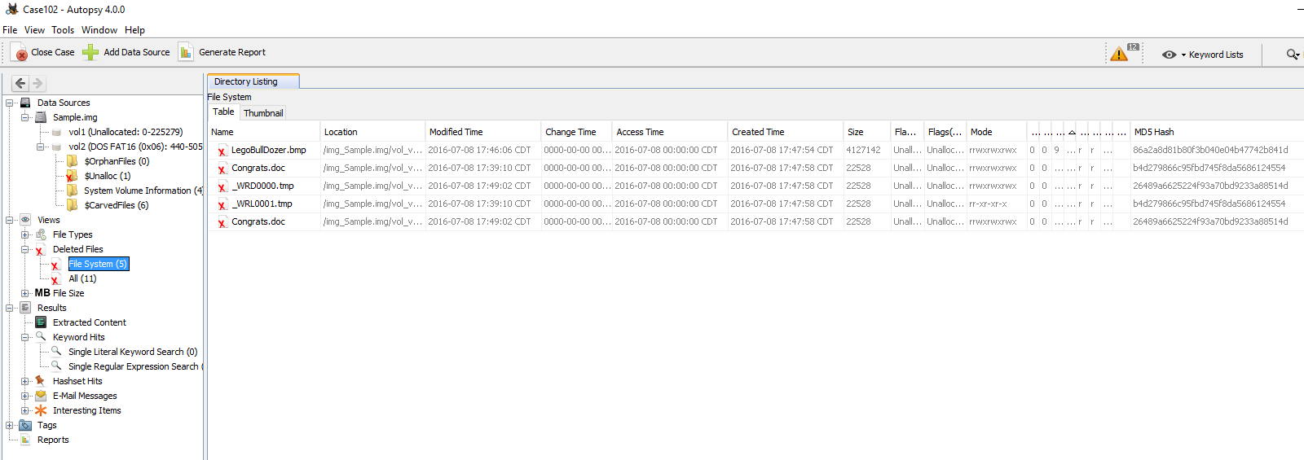
Deleted Files, Timeline, and File Signatures

Slide 23
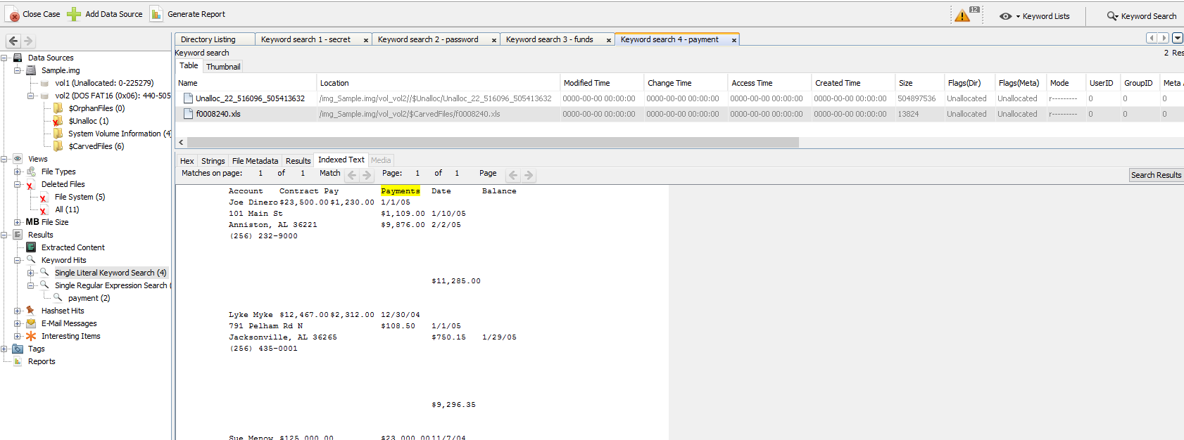
Keyword Search

Slide 24
Check for Understanding Q3
http://app.gosoapbox.com
Event code: 288095730
Which activity is not part of digital forensic analysis?
A. Establishing timeline of events
B. Isolating the digital device
C. Examining EXIF information
D. Searching for keywords

Slide 25
Steganography
The process of hiding messages or labels (digital watermarking)
Ranges from the most simple to the most sophisticated and elaborate

Slide 26
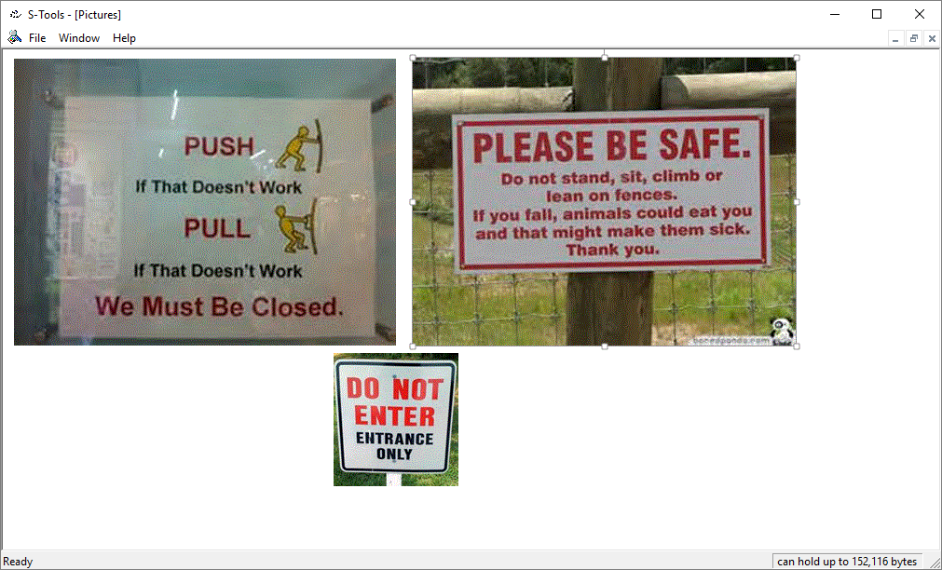
STools4

Slide 27
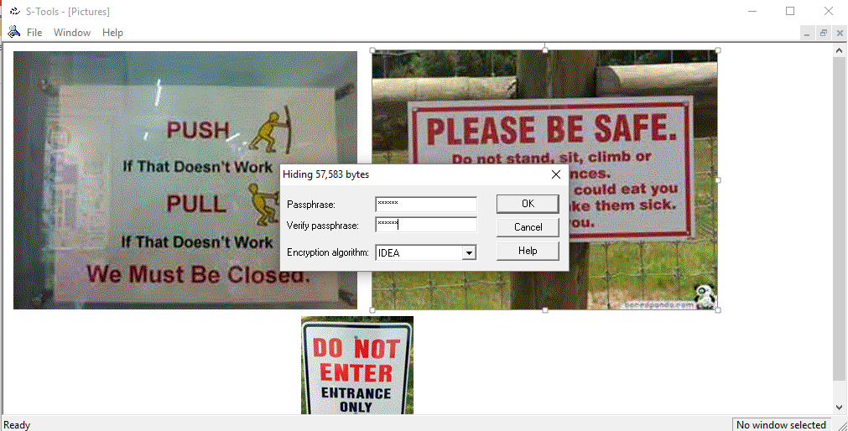
STools4

Slide 28

STools4
Right click
Save as….
Make sure that the filename has a bmp extension

Slide 29
Check for Understanding Q4
http://app.gosoapbox.com
Event code: 288095730
Steganography is an example of which cyber security principle?
A. Least privilege
B. Minimization
C. Information hiding
D. Abstraction

Slide 30

Additional Resources
Digital Forensic Tools:
http://www.gfi.com/blog/top-20-free-digital-forensic-investigation-tools-for-sysadmins
Iphone Forensic Analyzer:
http://tools.kali.org/forensics/iphone-backup-analyzer/
Iphone Forensic Open Source Tools:
https://downloads.nowsecure.com/viaForensics-iPhone-Forensics-with-FOSS.pdf
Open Source Mobile Forensics:
http://www.nist.gov/forensics/upload/6-Mahalik_OSMF.pdf

Slide 31

QUESTIONS

